Slide 1
Delegated Authority for Bootstrap Voucher Artifacts
draft-richardson-anima-voucher-delegation
M. Richardson
Liang Xia
Jie Yang(presenting)
IETF 107, ANIMA

Slide 2
Problem Statement of MASA concept
Pledge
(IDevID)
Join Proxy
Domain Registrar
(PKI RA)
Internet
MASA
BRSKI-EST
BRSKI-MASA
e.g. RFC7030
Voucher
(RFC 8366)
Key Infrs.
(e.g. PKI CA)
“Domain” components
RFC8366 vouchers require a MASA (manufacturer) to provide a voucher for each device
the manufacture can block secondary sales
a failed manufacturer’s device may become landfill
BRSKI (mostly) requires this to be an online service.
MASA must be reachable to the Registrar during on-boarding
Device owner is always strongly dependent on the MASA service
SZTP (RFC8572) works better for offline uses, but still has difficulties

Slide 3
Applicability of Delegated Voucher
Pledge
(IDevID)
Join Proxy
Domain Registrar
(PKI RA)
Internet
MASA
BRSKI-EST
BRSKI-MASA
e.g. RFC7030
Voucher
(RFC 8366)
Key Infrs.
(e.g. PKI CA)
“Domain” components
Second sale
From willing seller
Via creditor/bankruptcy, etc.
Manufacturer of assembly of composite devices , e.g:
A passenger rail car
Transparent Factory with many sensors/actuators
Disconnected owner (military base example)
Owner that uses cloud/public PKI for registrar
Each time the CA changes, it’s a “resale”

Slide 4
Shape of proposed solution
{
"ietf-voucher:voucher": {
"created-on": "2016-10-07T19:31:42Z",
"assertion": "logged",
"serial-number": "JADA123456789",
"idevid-issuer": "base64encodedvalue==",
"pinned-domain-cert": "base64encodedvalue==",
}
}
{
"ietf-delegated-voucher:voucher": {
"created-on": "2020-03-14T06:28:31Z",
“expire-on”: “2039-12-31T01:61:80Z”,
"assertion": "logged",
"serial-number": "JADA123456789",
"pinned-delegation-certificate-authority": [“DASAbase64cert=="],
"delegation-voucher":[DelegationVoucher1", " DelegationVoucher2", " DelegationVoucher3"],
"intermediate-identities": ["IntermediateId1", "IntermediateId2", "IntermediateId3"],
"delegation-countdown": 3,
}
}

Slide 5

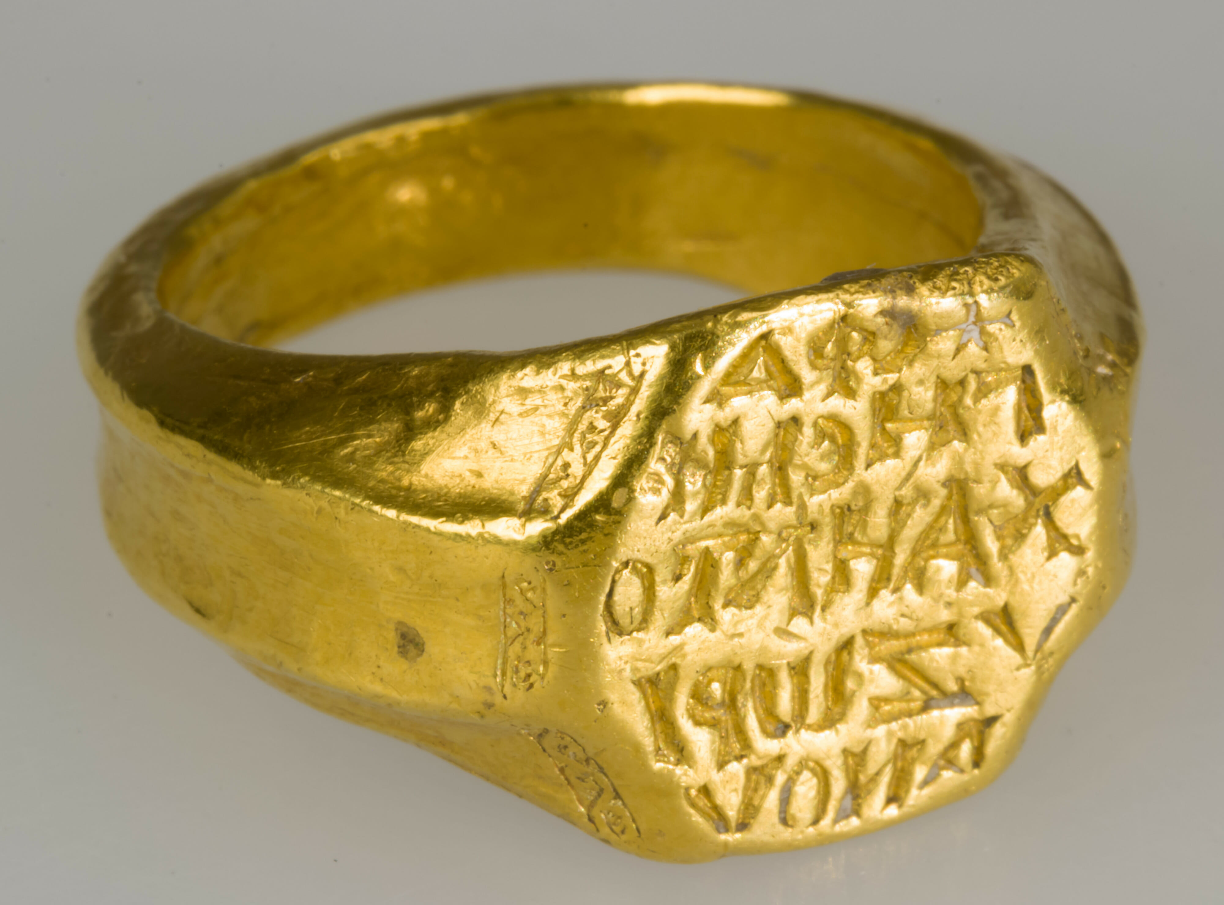

Proposed Structure: Second Sale
MASA
Ephemeral voucher + DV1
Delegated Voucher
(DV1)
Owner-1
Owner-2
Notes:
ephemeral ports：临时端口

Slide 6
Proposed Structure: Multiple Sale
MASA
DV2
Owner-1
Delegated Voucher
(DV1)
Ephemeral voucher
+ DV1 + DV2
Owner-2
Owner-3

Slide 7
Proposed Structure: Resale
Owner-1
Ephemeral voucher1 + VS
Intermediary
MASA
Long period voucher set
(VS)
Ephemeral voucher2 + VS
Owner-2
Notes:
转售

Slide 8
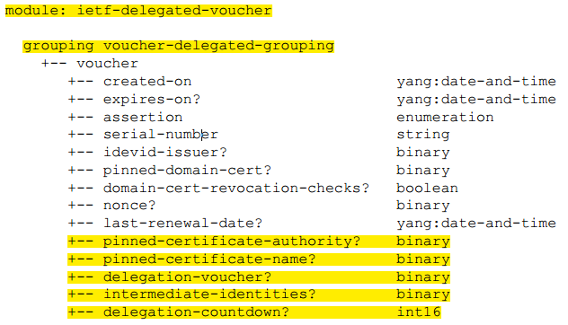
Issues to think about …
delegated voucher extension
pinned-certificate-authority:
Could this be omitted to use some DNS TLSA certification?
pinned-certificate-name:
Is it enough to pin an rfc822NAME, or do we need to be able to pin other DNs?
delegation-voucher:
This is a flag, like CA= True. Do we need it?
intermediate-identities:
This is voucher identity being consistent with delegation voucher. Do we need it?
delegation-countdown:
Do we need a way to limit how many times a delegation voucher can be created?
Do we do any of this for JSON format vouchers, or do it only for COSE signed CBOR vouchers?
I won't feel that this even close to complete until code is written
Registrar may need enhancing…

Slide 9
Thank You!

